Slide 1




HackOrbit 2025
CODE CRAFTERS

Slide 2

THEME :- HEALTHCARE TECHNOLOGY
PROBLEM STATEMENT
In rural and semi-urban India, people lack access to regular health monitoring systems. Manual record-keeping is inconvenient, and elderly or chronically ill patients struggle with medicine schedules and tracking vital data. This results in late detection of serious health issues and limited medical intervention opportunities.

Slide 3
PROPOSED SOLUTION
HealthTrack Web is a responsive, AI-assisted health tracking platform designed for users to:
✔️ Log daily health vitals: Temperature, Blood Pressure, SpO₂, Sugar levels with real-time input.
✔️ Visualize health trends dynamically: Interactive, responsive Chart.js graphs track changes over time.
✔️ Receive AI-powered health suggestions: Get instant, contextual advice for abnormal readings.
✔️ Animated health averages display: Smooth counters showcase average vitals for quick review.
✔️ Secure health log management: Add, edit, delete, or clear all records with SweetAlert2 popups for confirmations.
✔️ Export health reports: Download PDF summaries (via WeasyPrint) and CSV datasets effortlessly.
.

Slide 4
TECHNOLOGICAL STACK
Frontend:
HTML5
CSS3
Chart.js
SweetAlert2
PDF Export:
WeasyPrint
CSV Export:
Python CSV Module
Backend:
Python Flask
Database:
MySQL

Slide 5
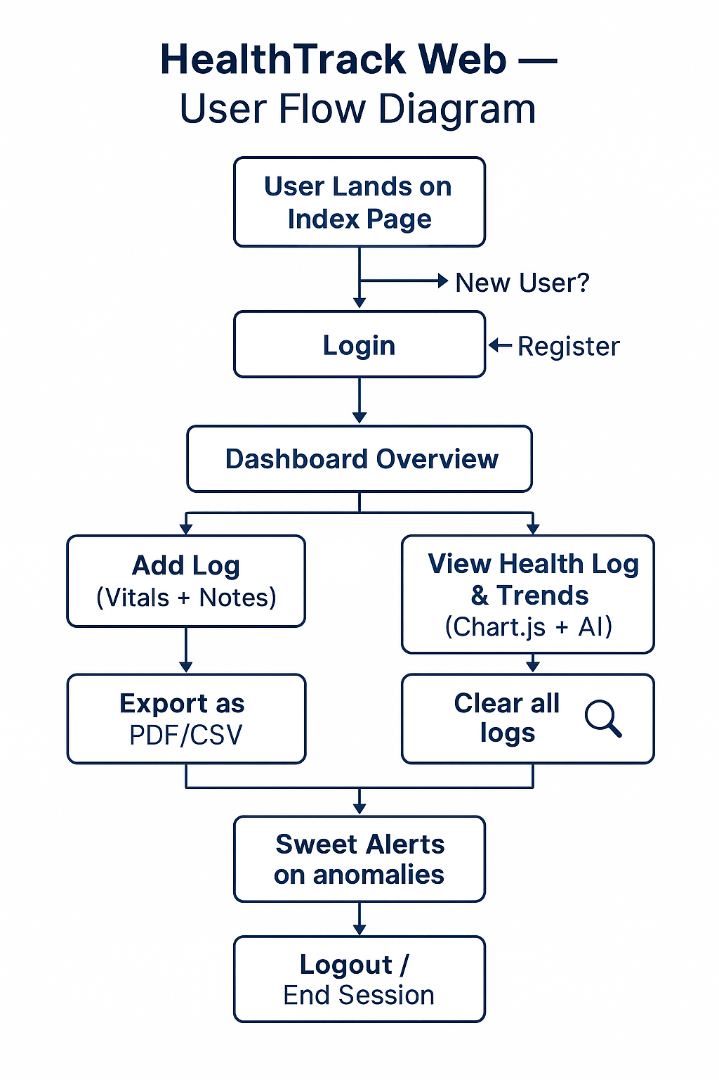
FLOWCHART

Slide 6
FLOWCHART
🔓 User Access:
📝 New users Register
🔐 Existing users Login
📊 Dashboard Functions:
➕ Add Health Logs: Temp, BP, SpO2, Sugar, Notes
📜 View Logs: Organized list with delete option
📈 Visualize Trends: Interactive line charts
🤖 AI Suggestions: Alerts on abnormal readings
📄 Reports & Exports:
📑 Generate PDF Report
📥 Download CSV Report
🧹 User Actions:
❌ Delete Individual Logs (with SweetAlert popups)
🗑️ Clear All Logs (with confirmation)
📊 Additional Highlights:
🔢 Animated Average Counters (Temp, SpO2, Sugar)
🎨 Attractive Landing Page with animation, background visuals, and contributor credits
.

Slide 7
FEATURES
✔️ User Registration & Login System ✔️ Add, Delete (with confirmation), and Clear Logs ✔️ Real-time AI-based alerts on abnormal values ✔️ Health Suggestions tailored to user logs ✔️ Graphical Health Trends via Chart.js ✔️ Animated Health Averages Counters ✔️ PDF & CSV Health Report Exports ✔️ Interactive and animated UI (SweetAlert, Counters, Styled Buttons) ✔️ Attractive Index Page with background visuals and animations

Slide 8
DRAWBACKS
Drawbacks:
Possible Improvements:
Integrate wearable device APIs (like Google Fit) in future versions.
Multilingual interface for wider accessibility.
Cloud hosting for better scalability.
Requires internet connectivity for logging and report generation
Manual input dependency could lead to skipped logs
Currently non-clinical, without automated device integration

Slide 9
TE
CODE CRAFTERS
Name | Contact
Pratham Kishor (Frontend and Backend) | prathamkishorroy2017@gmail.com 6207288126
Swasti Jain (Backend and Database) | swastijain114@gmail.com 7568750852

Slide 10
Thank you !

